Slide 1
Smashing the Stack
A quickie on buffer overflows

Slide 2
Overview
Definition
How it works - memory layout
What is the stack
Easy example
Your turn
Protections – stack canary, DEP, ASLR, mm arrangement
Ret2libc for DEP evasion

Slide 3
Basic Definition
What is a buffer overflow?
A buffer is any device, material, or apparatus used as a shield, cushion, or bumper, especially on machinery.
In computers it is a temporary storage “device”
Overflow is what happens when you leave the sink on
A buffer overflow occurs when adjacent items in memory write over one another
On a relatable level: When the person sharing your table has stuff that flows over on to your side

Slide 4
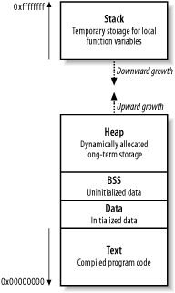
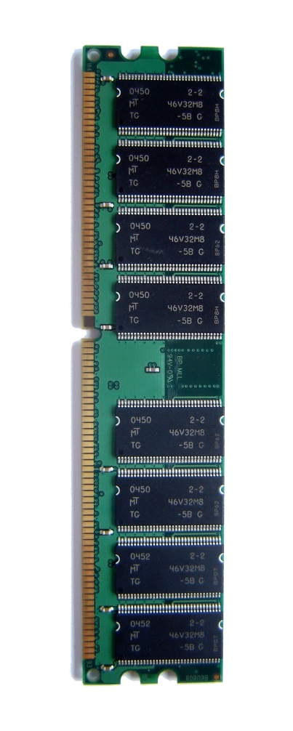
How Can This Happen?
Memory is allocated sequentially on the stack.
One variable in the stack might be stored at 0xfffffff, and its neighbor at 0xfffffff0

Slide 5
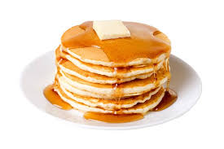
What is the stack?
The stack is a dynamically allocated, FILO memory arrangement
It is very similar to a stack of pancakes in the way it is utilized: 1. You place the first complete pancake on the bottom of the ‘stack’ and all others on top of it. (First In)
2. The first one you grab to eat is the one on top of the stack; the most recent pancake. Making the bottom pancake the last one you eat. (Last Out)
3. You can add more pancakes or cook less pancakes depending on how many people you feed or how hungry you are. (Dynamic)

Slide 6
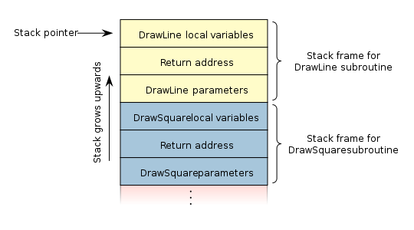
How do I eat this stack?
When a function is called, a stack is automatically built & it contains the local function variables, return address (where to go after it runs), and parameters used by the function.
The variables grow towards lower memory addresses, and are placed beside each other
This placement allows for an overflow to occur

Slide 7
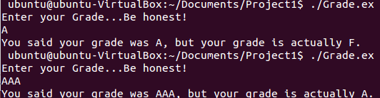
Lets take a look…
Example program: Prompts a student for their grade, and then tells them what their grade really was. It has both variables stored inside of Main’s stack.
When you enter more characters than intended, to a function that does not perform bounds checking, you can overwrite that bad grade to a great one!

Slide 8
Bounds checking?
Some functions will read in any amount of input without regards to how much space is allocated to their buffer (“in bounds”)
Dangerous functions are typically with strings because strings are so dynamic. Other variable types like integers, have a set maximal value.
Function | Applicability
gets() | Reads from stdin to string
sprintf() | Create string based on parameters
strcat() | Append contents of one strong to another
strcpy() | Copy contents of one string to another
vsprintf() | Create a string based on parameters
scanf() | Reads from stdin to string

Slide 9
Example functions
Strcpy without bounds checking:
Strcpy (“mollystewart”, buffer);
If the buffer is smaller than 13 characters, whatever does not fit in the buffer will overflow into the next variable storage
Strncpy preforms a bounds check:
Strncpy(“mollystewart”, buffer, 5);
Strncpy will only copy 5 bytes into the buffer

Slide 10
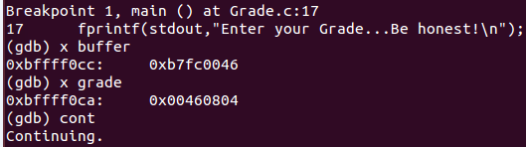
Stepping through the program
Within the GDB (Gnu Debugger) we can step through the simple C program I wrote and actually visualize this buffer overflowing.
Start by setting breakpoints in the program after the variables have been initialized, but before the user enters their input.
“buffer” is our pre-set variable: hex 0x46 = F
“grade” is the user entered grade

Slide 11

Notice Where the variables are in memory
Before the dangers function call of “scanf” the memory is arranged below
Remember the stack starts off by placing the first variable on the bottom, and the next initialized variable directly on top of it.

Slide 12
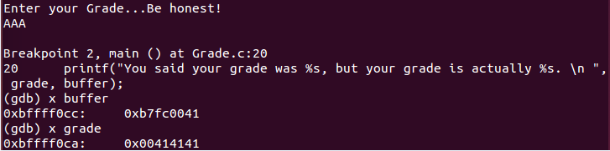

...and instant good grades!
The user input of “AAA” overwrote the buffer!

Slide 13
How can I prevent this?
If the order the variables were declared in were reversed, the stack would not have overflowed onto your hard-coded grade.
Proper memory management could have prevented the overflow from flowing downward into the user input
Using safe libraries with bounds checking also could have prevented this.

Slide 14
Stack canary – special saved value at the end of the stack which will change if you write over it
Change is noticed and program fails to continue
DEP (Data Execution Prevention)– disallows execution within the stack; ie you cannot fill your buffer with shellcode and execute it; however still vulnerable to ret2libc attacks
ASLR (Address System Layout Randomization) – to assist with randomizing address layout making ret2libc more difficult because address of system calls will change

